Slide 1
Community Detection and Behavior Study for Social Computing
Huan Liu⁺, Lei Tang⁺, and Nitin Agarwal*
⁺Arizona State University
*University of Arkansas at Little Rock
Updated slides available at http://www.public.asu.edu/~ltang9/
http://www.public.asu.edu/~huanliu/

Slide 2
Acknowledgements
We would like to express our sincere thanks to Jianping Zhang, John J. Salerno, Sun-Ki Chai, Xufei Wang, Sai Motoru and Reza Zafarani for collaboration, discussion, and valuable comments.
This work derives from the projects, in part, sponsored by AFOSR and ONR grants.
Some materials presented here can be found in the following book chapters and references section of this tutorial:
Lei Tang and Huan Liu, Graph Mining Applications to Social Network Analysis, in Managing and Mining Graph Data (forthcoming)
Lei Tang and Huan Liu, Understanding Group Structures and Properties in Social Media, in Link Mining: Models, Algorithms and Applications (forthcoming)
If you wish to use the ppt version of the slides, please contact (or email) us. The ppt version contains more comprehensive materials with additional information and notes and many animations.

Slide 3
Outline
Social Media
Data Mining Tasks
Evaluation
Principles of Community Detection
Communities in Heterogeneous Networks
Evaluation Methodology for Community Detection
Behavior Prediction via Social Dimensions
Identifying Influential Bloggers in a Community
A related tutorial on Blogosphere
Notes:
Social Computing definition
General: Social computing is concerned with the study of social behavior and social context based on computational systems.
Narrower definition: Data Mining with Social Media

Slide 4

Participating Web and Social Media

Slide 5



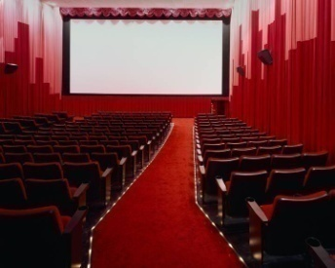


Traditional Media
Broadcast Media: One-to-Many
Communication Media: One-to-One

Slide 6












Social Media: Many-to-Many
Social Media
Social Networking
Blogs
Wiki
Forum
Content
Sharing
Notes:
There are various of social media: like social network , blogs, wiki, forums content sharing. Most of them are an open platform so users can connect with each other, generate content. These web 2.0 applications gained a lot of online traffic recently. They provide rich information about online users, also new tasks and challenges.

Slide 7
Traditional vs. Social Media
Traditional Media
Social Media
Broadcast media
One-to-Many
Radio
Television
Newspapers
Movies
Communication Media
One-to-One
Phone calls
Faxes
Instant Message
MySpace
Facebook
Twitter
Blog
Many-to-Many

Slide 8
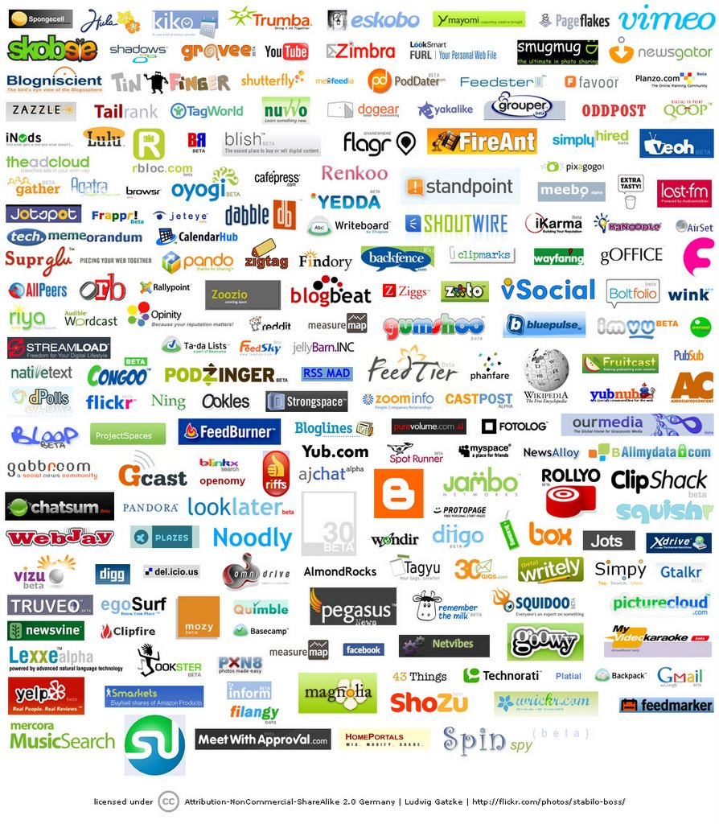
Web 2.0 Services (examples)
Blogs
Blogspot
Wordpress
Wikis
Wikipedia
Wikiversity
Social Networking Sites
Facebook
Myspace
Orkut
Digital media sharing websites
Youtube
Flickr
Social Tagging
Del.icio.us
Others
Twitter
Yelp
Notes:
WordPress – Express yourself
Twitter is a service for friends, family, and co–workers to communicate and stay connected through the exchange of quick, frequent answers to one simple question: What are you doing?
Yelp is the fun and easy way to find, review and talk about what’s great

Slide 9
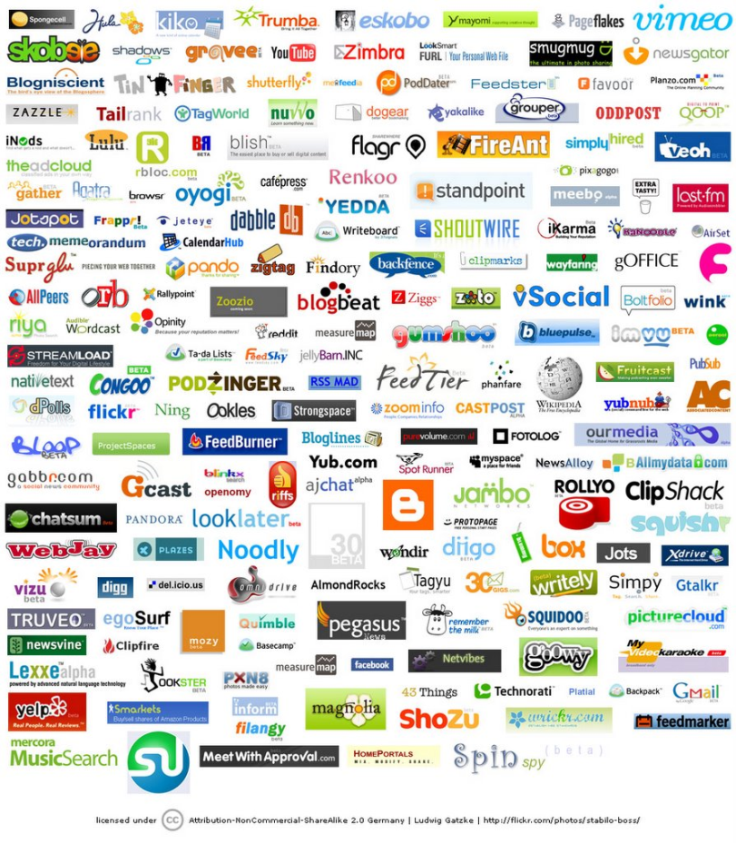
Characteristics of Social Media
Everyone can be a media outlet
Disappearing of communications barrier
Rich User Interaction
User-Generated Contents
User Enriched Contents
User developed widgets
Collaborative environment
Collective Wisdom
Long Tail
Broadcast Media
Filter, then Publish
Social Media
Publish, then Filter

Slide 10
Top 20 Most Visited Websites
Internet traffic report by Alexa on July 29th 2008
40% of the top 20 websites are Web 2.0 sites
1 | Yahoo! | 11 | Orkut
2 | Google | 12 | RapidShare
3 | YouTube | 13 | Baidu.com
4 | Windows Live | 14 | Microsoft Corporation
5 | Microsoft Network | 15 | Google India
6 | Myspace | 16 | Google Germany
7 | Wikipedia | 17 | QQ.Com
8 | Facebook | 18 | EBay
9 | Blogger | 19 | Hi5
10 | Yahoo! Japan | 20 | Google France
Notes:
Roughly 60 million American visit Wikipedia every month.
Since Michael Jackson died on June 25, the wikipedia article about him has been viewed more than 30 million times. With 6 million of those in the first 24 hours.

Slide 11
Top 20 Most Visited Websites
Internet traffic report by Alexa on August 27th, 2009
40% of the top 20 websites are social media sites
1 | Google | 11 | MySpace
2 | Yahoo! | 12 | Google India
3 | Facebook | 13 | Google Germany
4 | YouTube | 14 | Twitter
5 | Windows Live | 15 | QQ.Com
6 | Wikipedia | 16 | RapidShare
7 | Blogger | 17 | Microsoft Corporation
8 | Microsoft Network (MSN) | 18 | Google France
9 | Baidu.com | 19 | WordPress.com
10 | Yahoo! Japan | 20 | Google UK
Notes:
Roughly 60 million American visit Wikipedia every month.
Since Michael Jackson died on June 25, the wikipedia article about him has been viewed more than 30 million times. With 6 million of those in the first 24 hours.
Some web sites are becoming social (Baidu.com, QQ.com,

Slide 12

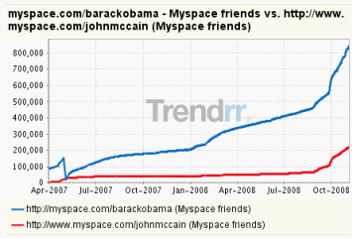
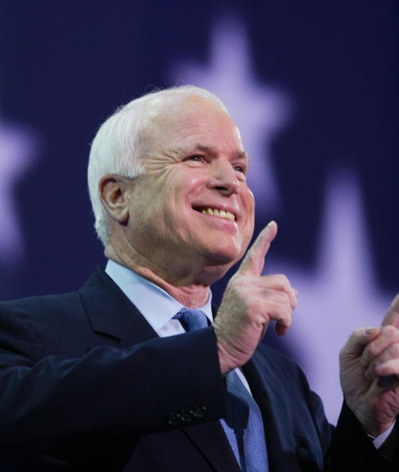
Social Media’s Important Role
"social networks will complement, and may replace, some government functions,"
Notes:
http://www.gartner.com/it/page.jsp?id=784212

Slide 13
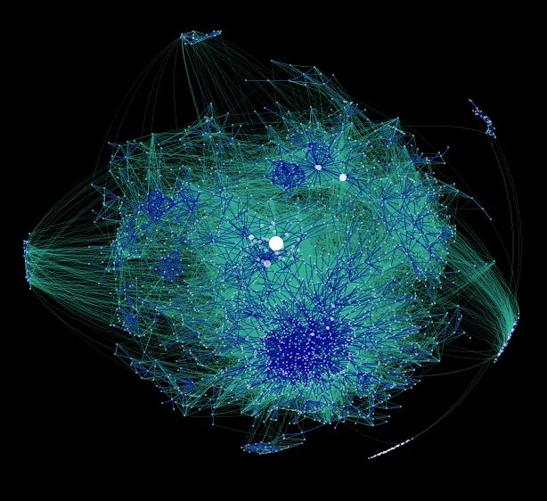
Social Networks and Data Mining

Slide 14
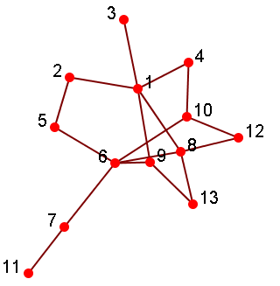
Social Networks
A social structure made of nodes (individuals or organizations) that are related to each other by various interdependencies like friendship, kinship, etc.
Graphical representation
Nodes = members
Edges = relationships
Various realizations
Social bookmarking (Del.icio.us)
Friendship networks (facebook, myspace)
Blogosphere
Media Sharing (Flickr, Youtube)
Folksonomies
Notes:
Folksonomy (also known as collaborative tagging, social classification, social indexing, and social tagging) is the practice and method of collaboratively creating and managing tags to annotate and categorizecontent.

Slide 15
Sociomatrix
Social networks can also be
represented in matrix form
 | 1 | 2 | 3 | 4 | 5 | 6 | 7 | 8 | 9 | 10 | 11 | 12 | 13
1 | 0 | 1 | 1 | 1 | 0 | 0 | 0 | 1 | 1 | 0 | 0 | 0 | 0
2 | 1 | 0 | 0 | 0 | 1 | 0 | 0 | 0 | 0 | 0 | 0 | 0 | 0
3 | 1 | 0 | 0 | 0 | 0 | 0 | 0 | 0 | 0 | 0 | 0 | 0 | 0
…

Slide 16
Social Computing and Data Mining
Social computing is concerned with the study of social behavior and social context based on computational systems.
Data Mining Related Tasks
Centrality Analysis
Community Detection
Classification
Link Prediction
Viral Marketing
Network Modeling

Slide 17
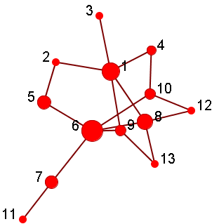
Centrality Analysis/Influence Study
Identify the most important actors in a social network
Given: a social network
Output: a list of top-ranking nodes
Top 5 important nodes:
6, 1, 8, 5, 10
(Nodes resized by
Importance)
Notes:
Based on betweenness: Vertices that occur on many shortest paths between other vertices have higher betweenness than those that do not.
In other words, if taking out node 6, the average distance between any two nodes of the remaining network can increase.

Slide 18
Community Detection
A community is a set of nodes between which the interactions are (relatively) frequent
a.k.a. group, subgroup, module, cluster
Community detection
a.k.a. grouping, clustering, finding cohesive subgroups
Given: a social network
Output: community membership of (some) actors
Applications
Understanding the interactions between people
Visualizing and navigating huge networks
Forming the basis for other tasks such as data mining

Slide 19
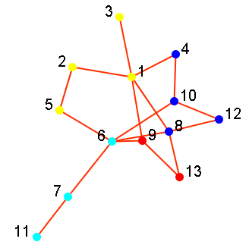
Visualization after Grouping
4 Groups:
{1,2,3,5}
{4,8,10,12}
{6,7,11}
{9,13}
(Nodes colored by
Community Membership)
Notes:
Modularity

Slide 20
Classification
User Preference or Behavior can be represented as class labels
Whether or not clicking on an ad
Whether or not interested in certain topics
Subscribed to certain political views
Like/Dislike a product
Given
A social network
Labels of some actors in the network
Output
Labels of remaining actors in the network

Slide 21
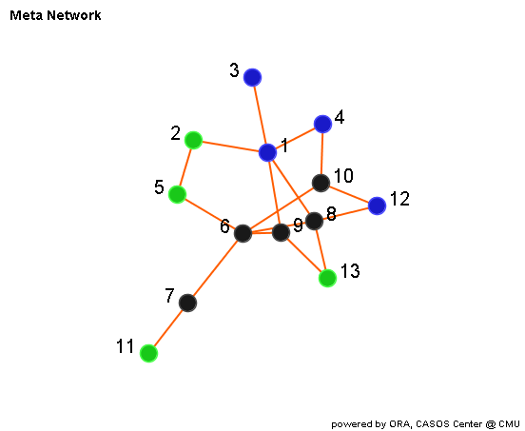
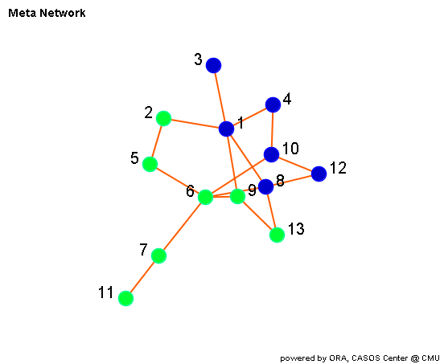
Visualization after Prediction
Predictions
6: Non-Smoking
7: Non-Smoking
8: Smoking
9: Non-Smoking 10: Smoking
: Smoking
: Non-Smoking
: ? Unknown

Slide 22
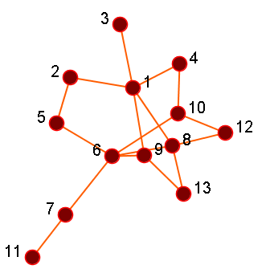
Link Prediction
Given a social network, predict which nodes are likely to get connected
Output a list of (ranked) pairs of nodes
Example: Friend recommendation in Facebook
Link Prediction
(2, 3)
(4, 12)
(5, 7)
(7, 13)

Slide 23
Viral Marketing/Outbreak Detection
Users have different social capital (or network values) within a social network, hence, how can one make best use of this information?
Viral Marketing: find out a set of users to provide coupons and promotions to influence other people in the network so my benefit is maximized
Outbreak Detection: monitor a set of nodes that can help detect outbreaks or interrupt the infection spreading (e.g., H1N1 flu)
Goal: given a limited budget, how to maximize the overall benefit?

Slide 24
An Example of Viral Marketing
Find the coverage of the whole network of nodes with the minimum number of nodes
How to realize it – an example
Basic Greedy Selection: Select the node that maximizes the utility, remove the node and then repeat
Select Node 1
Select Node 8
Select Node 7
Node 7 is not a node with
high centrality!

Slide 25
Network Modeling
Large Networks demonstrate statistical patterns:
Small-world effect (e.g., 6 degrees of separation)
Power-law distribution (a.k.a. scale-free distribution)
Community structure (high clustering coefficient)
Model the network dynamics
Find a mechanism such that the statistical patterns observed in large-scale networks can be reproduced.
Examples: random graph, preferential attachment process
Used for simulation to understand network properties
Thomas Shelling’s famous simulation: What could cause the segregation of white and black people
Network robustness under attack
Notes:
He wondered if racial segregation might, in principle, have absolutely nothing to do with racism.
First experiment – racism can cause segregation
Second experiment – racially tolerant people might prefer to avoid being part of extreme minority (< 30%)

Slide 26
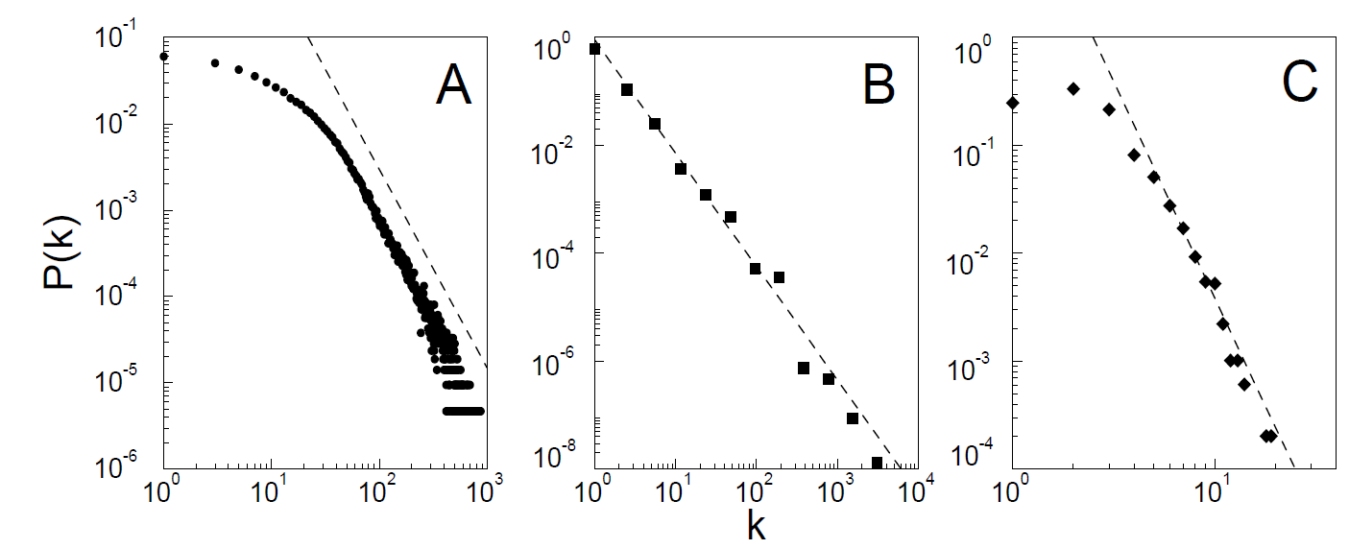
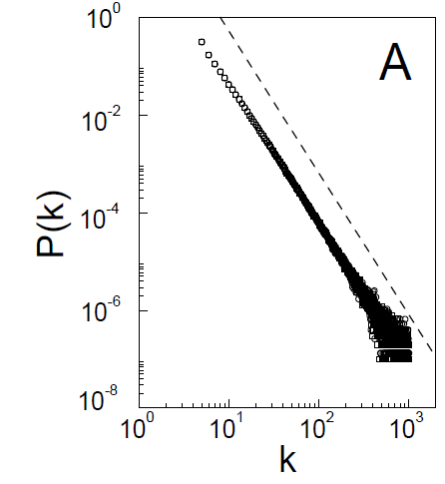
Comparing Network Models
observations over various
real-word large-scale networks
outcome of a
network model
(Figures borrowed from “Emergence of Scaling in Random Networks”)
Notes:
Last figure is a model of similar size to A.

Slide 27
Social Computing Applications
Advertizing via Social Networking
Behavior Modeling and Prediction
Epidemic Study
Collaborative Filtering
Crowd Mood Reader
Cultural Trend Monitoring
Visualization
Health 2.0
Notes:
Mining the Web for Feelings, Not Facts (an August NY Times article)

Slide 28
General Evaluation Measures

Slide 29
Basic Evaluation and Metrics
Assessment is an essential step
Comparing with some ground truth if available
Obviously, various tasks may require different ways of performance evaluation
Ranking
Clustering
Classification
An understanding of these concepts will help us to develop more pertinent evaluation methods.

Slide 30
Measuring a Ranked List
Normalized Discounted Cumulative Gain (NDCG)
Measuring relevance of returned search result
Multi levels of relevance (r): irrelevant (0), borderline (1), relevant (2)
Each relevant document contributes some gain to be cumulated
Gain from low ranked documents is discounted
Normalized by the maximum DCG
Notes:
http://sifaka.cs.uiuc.edu/course/410s08/410notes.pdf
Why NDCG?
Sensitive to the position of highest rated page
Log-discounting of results
Normalized for different lengths lists

Slide 31
NDCG - Example
4 documents: d₁, d₂, d₃, d₄
i | Ground Truth |  | Ranking Function₁ |  | Ranking Function₂
 | Document Order | r_{i} | Document Order | r_{i} | Document Order | r_{i}
1 | d4 | 2 | d3 | 2 | d3 | 2
2 | d3 | 2 | d4 | 2 | d2 | 1
3 | d2 | 1 | d2 | 1 | d4 | 2
4 | d1 | 0 | d1 | 0 | d1 | 0
 | NDCG_{GT}=1.00 |  | NDCG_{RF1}=1.00 |  | NDCG_{RF2}=0.9203

Slide 32
Comparing Two Ranked Lists
Rank correlation
Spearman’s rank correlation coefficient
Example
ρ = 1-(6*194/10*(10²-1))
= -0.175
X_{i} | Y_{i} | rank x_{i} | rank y_{i} | d_{i} | d_{i}²
86 | 0 | 1 | 1 | 0 | 0
97 | 20 | 2 | 6 | -4 | 16
99 | 28 | 3 | 8 | -5 | 25
100 | 27 | 4 | 7 | -3 | 9
101 | 50 | 5 | 10 | -5 | 25
103 | 29 | 6 | 9 | -3 | 9
106 | 7 | 7 | 3 | 4 | 16
110 | 17 | 8 | 5 | 3 | 9
112 | 6 | 9 | 2 | 7 | 49
113 | 12 | 10 | 4 | 6 | 36
Notes:
d is the difference or (x –y)
http://en.wikipedia.org/wiki/Spearman's_rank_correlation_coefficient

Slide 33
Concordance between a Pair
Rank correlation
[-1,1]: perfect agreement=1, perfect disagreement=-1
Kendall tau rankcorrelation coefficient
Example
Person | A | B | C | D | E | F | G | H
Rank by Height | 1 | 2 | 3 | 4 | 5 | 6 | 7 | 8
Rank by Weight | 3 | 4 | 1 | 2 | 5 | 7 | 8 | 6
P = 5 + 4 + 5 + 4 + 3 + 1 + 0 + 0 = 22
τ = (4*22/8*7 )-1= (88/56)-1 = 0.57
Notes:
http://www.itl.nist.gov/div898/software/dataplot/refman2/auxillar/kendell.htm
A term in P is the number of items that remain in agreement in the two comparing lists

Slide 34
Measuring a Classification Result
Confusion Matrix
Measures:
 | Prediction (+) | Prediction (-)
Truth (+) | True Positive (tp) | False Positive (fn)
Truth (-) | False Positive (fp) | True Negative (tn)
Predicted
+
+
-

Slide 35
F-measure Example
Predictions
6: Non-Smoking
7: Non-Smoking
8: Smoking
9: Non-Smoking 10: Smoking
Truth
6: Smoking
7: Non-Smoking
8: Smoking
9: Smoking 10: Smoking
 | Truth (+) | Truth (-)
Prediction (+) | 2 (node 8, 10) | 0
Prediction (-) | 2 (node 6, 9) | 1 (node 7)
: Smoking
: Non-Smoking
: ? Unknown
Accuracy = (2+1)/ 5 = 60%
Precision = 2/(2+0)= 100%
Recall = 2/(2+2) = 50%
F-measure= 2*100% * 50% / (100% + 50%) = 2/3
Notes:
Precision – among predicted true, how many are really, predicted true (true positive)
Recall – among all real true, how many are really, predicted true (true positive)

Slide 36
Measuring a Clustering Result
1, 2, 3
3, 4, 5
1, 4
2, 5
3, 6
Ground Truth
Clustering Result
How to measure the
clustering quality?
The number of communities after grouping can be different from the ground truth
No clear community correspondence between clustering result and the ground truth
Normalized Mutual Information can be used
Notes:
Normalized mutual information considers all the possible community matching between the ground truth and the clustering result

Slide 37
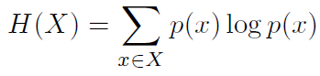
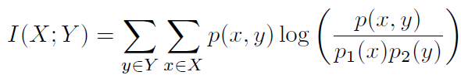
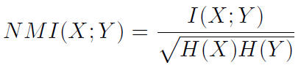
Normalized Mutual Information
Entropy: the information contained in a distribution
Mutual Information: the shared information between two distributions
Normalized Mutual Information (between 0 and 1)
Consider a partition as a distribution (probability of one node falling into one community), we can compute the matching between two clusterings
Notes:
We normalize MI so that we can compare more than two clusterings, e.g., clusterings A, B, C

Slide 38
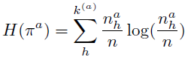
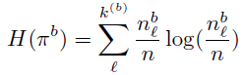
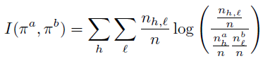
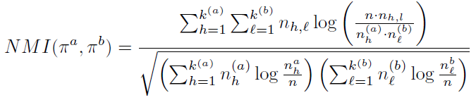
NMI
Notes:
Pi_a, Pi_b denote different partitions.
n_h^a is the number of nodes in Partition a assigned to h-th community;
n_l^b is the number of nodes in Partition b assigned to l-th community;
n_h, l is the number of nodes assigned to h-th community in partitition a, and l-th community in partition b.
k^{(a)} is the number of communities in partition a,
k^{(b)} is the number of communities in partition b.

Slide 39
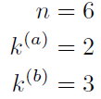
NMI-Example
Partition a: [1, 1, 1, 2, 2, 2]
Partition b: [1, 2, 1, 3, 3, 3]
1, 2, 3
4, 5, 6
1, 3
2
4, 5,6
h=1 | 3
h=2 | 3
l=1 | 2
l=2 | 1
l=3 | 3
 | l=1 | l=2 | l=3
h=1 | 2 | 1 | 0
h=2 | 0 | 0 | 3
=0.8278

Slide 40
Outline
Social Media
Data Mining Tasks
Evaluation
Principles of Community Detection
Communities in Heterogeneous Networks
Evaluation Methodology for Community Detection
Behavior Prediction via Social Dimensions
Identifying Influential Bloggers in a Community
A related tutorial on Blogosphere
Notes:
Social Computing definition
General: Social computing is concerned with the study of social behavior and social context based on computational systems.
Narrower definition: Data Mining with Social Media

Slide 41

Principles of Community Detection

Slide 42
Communities
Community: “subsets of actors among whom there are relatively strong, direct, intense, frequent or positive ties.”
-- Wasserman and Faust, Social Network Analysis, Methods and Applications
Community is a set of actors interacting with each other frequently
e.g. people attending this conference
A set of people without interaction is NOT a community
e.g. people waiting for a bus at station but don’t talk to each other
People form communities in Social Media

Slide 43

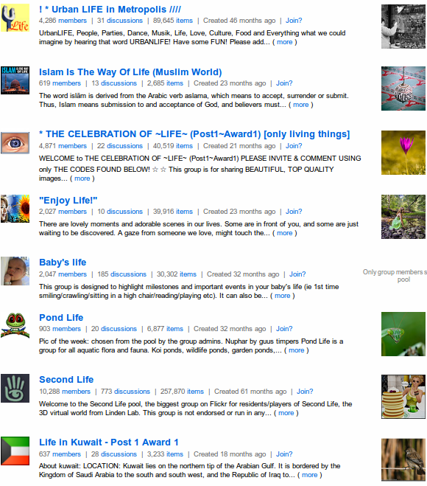
Example of Communities
Communities from
Facebook
Communities from
Flickr

Slide 44
Why Communities in Social Media?
Human beings are social
Part of Interactions in social media is a glimpse of the physical world
People are connected to friends, relatives, and colleagues in the real world as well as online
Easy-to-use social media allows people to extend their social life in unprecedented ways
Difficult to meet friends in the physical world, but much easier to find friend online with similar interests

Slide 45
Community Detection
Community Detection: “formalize the strong social groups based on the social network properties”
Some social media sites allow people to join groups, is it necessary to extract groups based on network topology?
Not all sites provide community platform
Not all people join groups
Network interaction provides rich information about the relationship between users
Groups are implicitly formed
Can complement other kinds of information
Help network visualization and navigation
Provide basic information for other tasks
Notes:
Groups are not active: the group members seldom talk to each other
Explicitly vs. implicitly formed groups

Slide 46
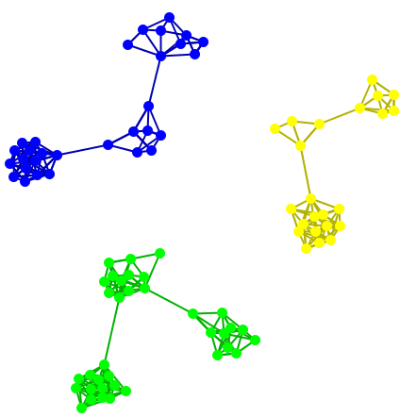
Subjectivity of Community Definition
Each component is a community
A densely-knit community
Definition of a community
can be subjective.
Notes:
No objective definition for a community
Visualization might help, but only for small networks
Real-world networks tend to be noisy
Need a proper criteria

Slide 47
Taxonomy of Community Criteria
Criteria vary depending on the tasks
Roughly, community detection methods can be divided into 4 categories (not exclusive):
Node-Centric Community
Each node in a group satisfies certain properties
Group-Centric Community
Consider the connections within a group as a whole. The group has to satisfy certain properties without zooming into node-level
Network-Centric Community
Partition the whole network into several disjoint sets
Hierarchy-Centric Community
Construct a hierarchical structure of communities

Slide 48
Node-Centric Community Detection
Community Detection
Node-Centric
Group-Centric
Network-Centric
Hierarchy-Centric

Slide 49
Node-Centric Community Detection
Nodes satisfy different properties
Complete Mutuality
cliques
Reachability of members
k-clique, k-clan, k-club
Nodal degrees
k-plex, k-core
Relative frequency of Within-Outside Ties
LS sets, Lambda sets
Commonly used in traditional social network analysis
Here, we discuss some representative ones

Slide 50
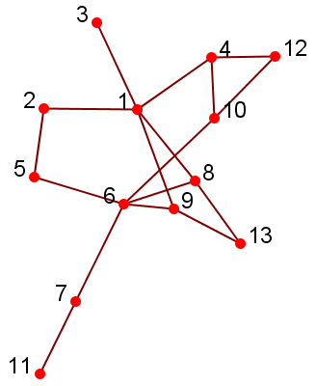
Complete Mutuality: Clique
A maximal complete subgraph of three or more nodes all of which are adjacent to each other
NP-hard to find the maximal clique
Recursive pruning: To find a clique of size k, remove those nodes with less than k-1 degrees
Very strict definition, unstable
Normally use cliques as a core or seed to explore larger communities

Slide 51
Geodesic
Reachability is calibrated by the Geodesic distance
Geodesic: a shortest path between two nodes (12 and 6)
Two paths: 12-4-1-2-5-6, 12-10-6
12-10-6 is a geodesic
Geodesic distance: #hops in geodesic between two nodes
e.g., d(12, 6) = 2, d(3, 11)=5
Diameter: the maximal geodesic distance for any 2 nodes in a network
#hops of the longest shortest path
Diameter = 5
Notes:
6 degrees of separation is the average distance, not the maximum one.

Slide 52
Reachability: k-clique, k-club
Any node in a group should be reachable in k hops
k-clique: a maximal subgraph in which the largest geodesic distance between any nodes <= k
A k-clique can have diameter larger than k within the subgraph
e.g., 2-clique {12, 4, 10, 1, 6}
Within the subgraph d(1, 6) = 3
k-club: a substructure of diameter <= k
e.g., {1,2,5,6,8,9}, {12, 4, 10, 1} are 2-clubs
Notes:
V1, v2, v3, v4, v5 is also a 3-clan
Both k-clans and k-clubs are k-cliques.
Node-centric community definition are either too strict , or it is too time-consuming to find the groups.

Slide 53
Nodal Degrees: k-plex, k-core
Each node should have a certain number of connections to nodes within the group
k-core: a substracture that each node connects to at least k members within the group
k-plex: for a group with n_{s} nodes, each node should be adjacent no fewer than n_{s}-k in the group
The definitions are complementary
A k-core is a (n_{s}-k)-plex
Networks in social media tend to follow a power law distribution, are k-plex and k-core suitable for large-scale network analysis?
Notes:
The union of k-core is still a k-core.

Slide 54
Within-Outside Ties: LS sets
LS sets: Any of its proper subsets has more ties to other nodes in the group than outside the group
Too strict, not reasonable for network analysis
A relaxed definition is Lambda sets
Require the computation of edge-connectivity between any pair of nodes via minimum-cut, maximum-flow algorithm

Slide 55
Recap of Node-Centric Communities
Each node has to satisfy certain properties
Complete mutuality
Reachability
Nodal degrees
Within-Outside Ties
Limitations:
Too strict, but can be used as the core of a community
Not scalable, commonly used in network analysis with small-size network
Sometimes not consistent with property of large-scale networks
e.g., nodal degrees for scale-free networks

Slide 56
Group-Centric Community Detection
Community Detection
Node-Centric
Group-Centric
Network-Centric
Hierarchy-Centric

Slide 57
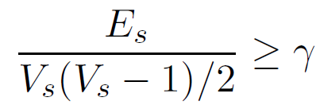
Group-Centric Community Detection
Consider the connections within a group as whole,
OK for some nodes to have low connectivity
A subgraph with V_{s} nodes and E_{s} edges is a γ-dense quasi-clique if
Recursive pruning:
Sample a subgraph, find a maximal γ-dense quasi-clique (the resultant size = k)
Remove the nodes that
whose degree < k^{γ}
all their neighbors with degree < k^{γ}
Notes:
A greedy algorithm is adopted to find a maximal quasi-clique
Starting from the node with largest degree, expanding it with nodes that are likely to contribute to a larger quasi-clique
Continue until no more nodes can be added

Slide 58
Network-Centric Community Detection
Community Detection
Node-Centric
Group-Centric
Network-Centric
Hierarchy-Centric

Slide 59
Network-Centric Community Detection
To form a group, we need to consider the connections of the nodes globally.
Goal: partition the network into disjoint sets
Groups based on Node Similarity
Groups based on Latent Space Model
Groups based on Block Model Approximation
Groups based on Cut Minimization
Groups based on Modularity Maximization

Slide 60
Node Similarity
Node similarity is defined by how similar their interaction patterns are
Two nodes are structurally equivalent if they connect to the same set of actors
e.g., nodes 8 and 9 are structurally equivalent
Groups are defined over equivalent nodes
Too strict
Rarely occur in a large-scale
Relaxed equivalence class is difficult to compute
In practice, use vector similarity
e.g., cosine similarity, Jaccard similarity
Notes:
Related to positional analysis

Slide 61
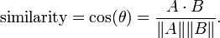
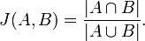
Vector Similarity
 | 1 | 2 | 3 | 4 | 5 | 6 | 7 | 8 | 9 | 10 | 11 | 12 | 13
5 |  | 1 |  |  |  | 1
8 | 1 |  |  |  |  | 1 |  |  |  |  |  |  | 1
9 | 1 |  |  |  |  | 1 |  |  |  |  |  |  | 1
a vector
structurally
equivalent
Cosine Similarity:
Jaccard Similarity:

Slide 62
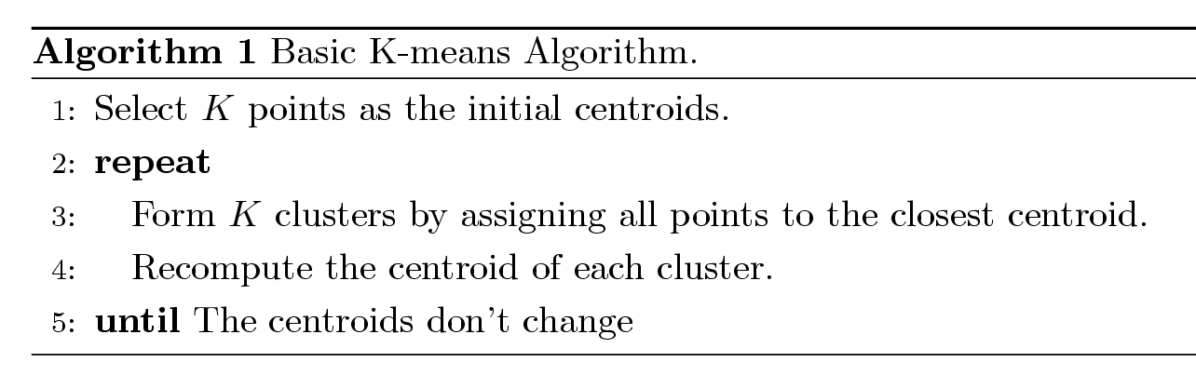
Clustering based on Node Similarity
For practical use with huge networks:
Consider the connections as features
Use Cosine or Jaccard similarity to compute vertex similarity
Apply classical k-means clustering Algorithm
K-means Clustering Algorithm
Each cluster is associated with a centroid (center point)
Each node is assigned to the cluster with the closest centroid

Slide 63
Illustration of k-means clustering

Slide 64
Shingling
Pair-wise computation of similarity can be time consuming with millions of nodes
Shingling can be exploited
Mapping each vector into multiple shingles so the Jaccard similarity between two vectors can be computed by comparing the shingles
Implemented using a quick hash function
Similar vectors share more shingles after transformation
Nodes of the same shingle can be considered belonging to one community
In reality, we can apply 2-level shingling

Slide 65
Fast Two-Level Shingling
Nodes
1
2
3
4
5
6
1st level
shingling
Shingles
2nd level
shingling
Meta-Shingles
1, 2, 3, 4
2, 3, 4, 5, 6

Slide 66
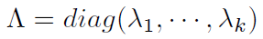
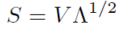
Groups on Latent-Space Models
Latent-space models: Transform the nodes in a network into a lower-dimensional space such that the distance or similarity between nodes are kept in the Euclidean space
Multidimensional Scaling (MDS)
Given a network, construct a proximity matrix to denote the distance between nodes (e.g. geodesic distance)
Let D denotes the square distance between nodes
denotes the coordinates in the lower-dimensional space
Objective: minimize the difference
Let (the top-k eigenvalues of ), V the top-k eigenvectors
Solution:
Apply k-means to S to obtain clusters

Slide 67
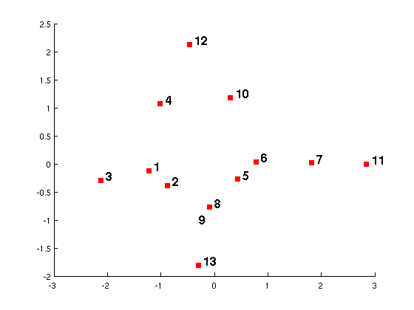
MDS-example
1, 2, 3, 4, 10, 12
5, 6, 7, 8, 9, 11, 13
k-means
S
Geodesic Distance Matrix
-1.22 | -0.12
-0.88 | -0.39
-2.12 | -0.29
-1.01 | 1.07
0.43 | -0.28
0.78 | 0.04
1.81 | 0.02
-0.09 | -0.77
-0.09 | -0.77
0.30 | 1.18
2.85 | 0.00
-0.47 | 2.13
-0.29 | -1.81
 | 1 | 2 | 3 | 4 | 5 | 6 | 7 | 8 | 9 | 10 | 11 | 12 | 13
1 | 0 | 1 | 1 | 1 | 2 | 2 | 3 | 1 | 1 | 2 | 4 | 2 | 2
2 | 1 | 0 | 2 | 2 | 1 | 2 | 3 | 2 | 2 | 3 | 4 | 3 | 3
3 | 1 | 2 | 0 | 2 | 3 | 3 | 4 | 2 | 2 | 3 | 5 | 3 | 3
4 | 1 | 2 | 2 | 0 | 3 | 2 | 3 | 2 | 2 | 1 | 4 | 1 | 3
5 | 2 | 1 | 3 | 3 | 0 | 1 | 2 | 2 | 2 | 2 | 3 | 3 | 3
6 | 2 | 2 | 3 | 2 | 1 | 0 | 1 | 1 | 1 | 1 | 2 | 2 | 2
7 | 3 | 3 | 4 | 3 | 2 | 1 | 0 | 2 | 2 | 2 | 1 | 3 | 3
8 | 1 | 2 | 2 | 2 | 2 | 1 | 2 | 0 | 2 | 2 | 3 | 3 | 1
9 | 1 | 2 | 2 | 2 | 2 | 1 | 2 | 2 | 0 | 2 | 3 | 3 | 1
10 | 2 | 3 | 3 | 1 | 2 | 1 | 2 | 2 | 2 | 0 | 3 | 1 | 3
11 | 4 | 4 | 5 | 4 | 3 | 2 | 1 | 3 | 3 | 3 | 0 | 4 | 4
12 | 2 | 3 | 3 | 1 | 3 | 2 | 3 | 3 | 3 | 1 | 4 | 0 | 4
13 | 2 | 3 | 3 | 3 | 3 | 2 | 3 | 1 | 1 | 3 | 4 | 4 | 0
MDS
Notes:
Node 3 and 5 are furthest, so in the mapped space, 3 and 11 are far away.
For nodes 8 and 9, they map to exactly the same location as the distance to all the other nodes are the same.

Slide 68
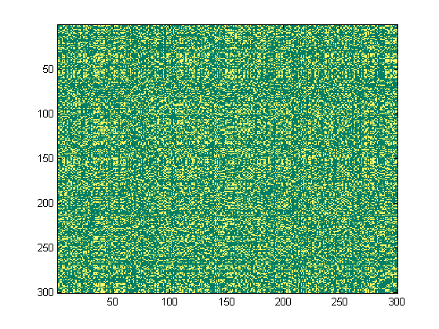
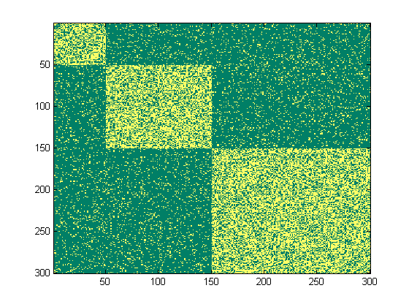
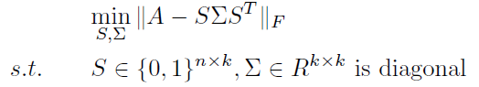
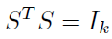
Block-Model Approximation
After
Reordering
Network Interaction Matrix
Block Structure
Objective: Minimize the difference between an interaction matrix and a block structure
Challenge: S is discrete, difficult to solve
Relaxation: Allow S to be continuous satisfying
Solution: the top eigenvectors of A
Post-Processing: Apply k-means to S to find the partition
S is a community indicator matrix
Notes:
L is the loss function, A is the network interaction matrix, \sigma is a diagonal matrix represents the interaction density, and S is the indicator matrix
Need to introduce the community indicator here

Slide 69
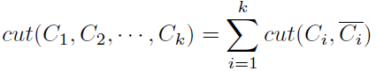
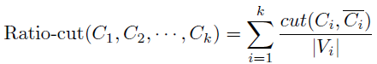
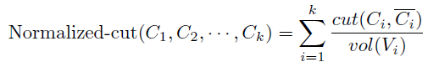
Cut-Minimization
Between-group interactions should be infrequent
Cut: number of edges between two sets of nodes
Objective: minimize the cut
Limitations: often find communities of
only one node
Need to consider the group size
Two commonly-used variants:
Cut=2
Number of nodes in a community
Cut =1
Number of within-group Interactions

Slide 70
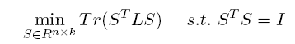
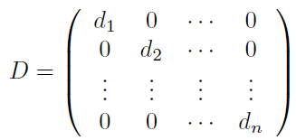
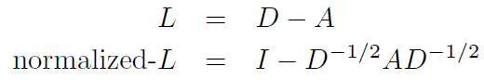
Graph Laplacian
Can be relaxed into the following min-trace problem
L is the (normalized) Graph Laplacian
Solution: S are the eigenvectors of L with smallest eigenvalues (except the first one)
Post-Processing: apply k-means to S
a.k.a.Spectral Clustering
Notes:
The first eigenvectors essentially represents all the nodes belong to one community, not very interesting

Slide 71
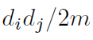
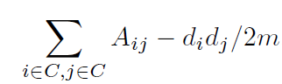
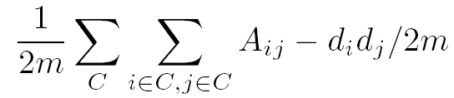
Modularity Maximization
Modularity measures the group interactions compared with the expected random connections in the group
In a network with m edges, for two nodes with degree d_{i} and d_{j ,} the expected random connections between them are
The interaction utility in a group:
To partition the group into multiple groups, we maximize
Expected Number of
edges between 6 and 9 is
5*3/(2*17) = 15/34
max
Notes:
Most previous methods do not consider the degree distribution of nodes.
2m is added to normalize the modularity between -1 and 1.
Larger modularity means the interaction is substantiallyfrquent than random. Thus, should be a community.

Slide 72
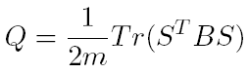
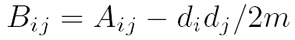
Modularity Matrix
The modularity maximization can also be formulated in matrix form
B is the modularity matrix
Solution: top eigenvectors of the modularity matrix

Slide 73
Properties of Modularity
Properties of modularity:
Between (-1, 1)
Modularity = 0 If all nodes are clustered into one group
Can automatically determine optimal number of clusters
Resolution limit of modularity
Modularity maximization might return a community consists multiple small modules

Slide 74
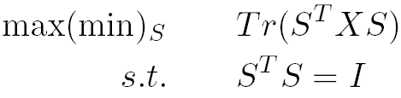
Matrix Factorization Form
For latent space models, block models, spectral clustering and modularity maximization
All can be formulated as
(Latent Space Models)
Sociomatrix (Block Model Approximation)
Graph Laplacian (Cut Minimization)
Modularity Matrix (Modularity maximization)
X=

Slide 75
Recap of Network-Centric Community
Network-Centric Community Detection
Groups based on Node Similarity
Groups based on Latent Space Models
Groups based on Cut Minimization
Groups based on Block-Model Approximation
Groups based on Modularity maximization
Goal: Partition network nodes into several disjoint sets
Limitation: Require the user to specify the number of communities beforehand

Slide 76
Hierarchy-Centric Community Detection
Community Detection
Node-Centric
Group-Centric
Network-Centric
Hierarchy-Centric

Slide 77
Hierarchy-Centric Community Detection
Goal: Build a hierarchical structure of communities based on network topology
Facilitate the analysis at different resolutions
Representative Approaches:
Divisive Hierarchical Clustering
Agglomerative Hierarchical Clustering

Slide 78
Divisive Hierarchical Clustering
Divisive Hierarchical Clustering
Partition the nodes into several sets
Each set is further partitioned into smaller sets
Network-centric methods can be applied for partition
One particular example is based on edge-betweenness
Edge-Betweenness: Number of shortest paths between any pair of nodes that pass through the edge
Between-group edges tend to have larger edge-betweenness

Slide 79
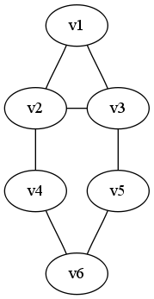
Divisive clustering on Edge-Betweenness
3
3
3
Progressively remove edges with the highest betweenness
Remove e(2,4), e(3, 5)
Remove e(4,6), e(5,6)
Remove e(1,2), e(2,3), e(3,1)
5
5
4
4
root
V1,v2,v3
V4, v5, v6
v1
v2
v3
v4
v5
v6

Slide 80
Agglomerative Hierarchical Clustering
Initialize each node as a community
Choose two communities satisfying certain criteria and merge them into larger ones
Maximum Modularity Increase
Maximum Node Similarity
root
V1, v2, v3
V4, v5, v6
V1,v2
v3
v4
V1,v2
v1
v2
(Based on Jaccard Similarity)
v5
v6
Notes:
A Hierarchy constructed based on Jaccard similarity

Slide 81
Recap of Hierarchical Clustering
Most hierarchical clustering algorithm output a binary tree
Each node has two children nodes
Might be highly imbalanced
Agglomerative clustering can be very sensitive to the nodes processing order and merging criteria adopted.
Divisive clustering is more stable, but generally more computationally expensive

Slide 82

Summary of Community Detection
The Optimal Method?
It varies depending on applications, networks, computational resources etc.
Scalability can be a concern for networks in social media
Other lines of research
Communities in directed networks
Overlapping communities
Community evolution
Group profiling and interpretation

Slide 83
Communities in Heterogeneous Networks

Slide 84
Heterogeneous Network
Heterogeneous kinds of objects in social media
YouTube
Users, tags, videos, ads
Del.icio.us
Users, tags, bookmarks
Heterogeneous types of interactions between actors
Facebook
Send email, leave a message
write a comment, tag photos
Same users interacting at different sites
Facebook, YouTube, Twitter
Notes:
Multi-mode network is called meta-network as well.
Multi-dimensional network sometimes are called multi-relational network.

Slide 85
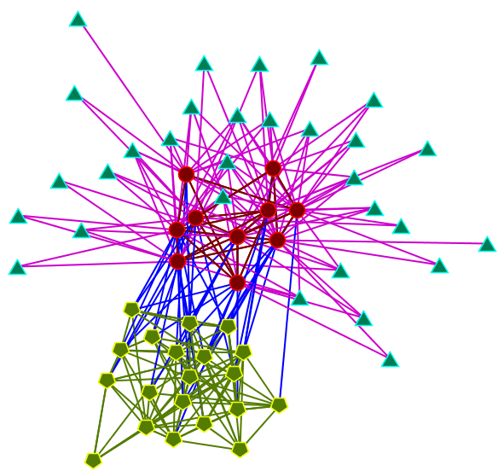
Multi-Mode Network
Networks consists of multiple modes of nodes
a.k.a. meta network
Users
Videos
Tags
3-Mode Network
in YouTube
Visualization of a
3-mode network

Slide 86




Multi-Dimensional Network
Contacts/friends
Tagging on Social Content
Fans/Subscriptions
Response to Social Content
………………
Network of
Multiple Dimensions
Networks consists of heterogeneous links between nodes
a.k.a. multi-relational networks, multi-link networks

Slide 87

fans
vote
comment
friends

Slide 88
Does Heterogeneity Matter?
Social Media presents heterogeneity in networks
Can we simply ignore the heterogeneity?
NO
Networks in Social Media are Noisy
Notes:
Some users can have more than 1000 friends

Slide 89


Example of noisy friends network
Too many friends?
Too few friends?
Friends network tells limited info for some users
Interaction at other modes or dimensions might help
Just One Contact
2410 friends!!

Slide 90
Reducing the Noise
A multi-mode network presents correlations between different kinds of objects
e.g., Users of similar interests are likely to have similar tags
Multi-dimensional networks can present complementary information at different dimensions
e.g., Some users seldom send email to each other, but might comment on each other’s photos
Taking into account of heterogeneity helps reduce the noise
Notes:
Some users can have more than 1000 friends

Slide 91
Problem Statement
Communities in Multi-Mode Networks
Find out communities of each mode
Communities in Multi-Dimensional Networks
Discover communities shared across different dimensions

Slide 92




Block Model for Multi-Mode Network
A₁
C₁
X
∑₁
X
C₂^{T}
=
Mode 1
Mode 1
A₁
A₃
Mode-2
Mode-2
Mode-3
Mode-3
A₂
Notes:
We aim to find communities at each mode

Slide 93

Alternating Optimization
No analytical solution
Iteratively compute the optimal clustering in one mode while fixing the clustering of other modes
C_{j} corresponds to the top left-singular vectors of P, which is concatenated by the following matrix in column-wise:
Essentially apply PCA to data of the above format
the clustering results of other modes provide structural features
Notes:
PCA is a special case of MDS

Slide 94
Shared Community Structure in Multi-Dimensional Networks
A latent community structure is shared in a multi-dimensional network
a group sharing similar interests
users interacted at different social media sites
Goal: Find out the shared community structure by integrating the network information of different dimensions

Slide 95

Communities in Multi-Dimensional Networks
Multi-Dimensional
Networks
Extract Structural
Features via
Community Detection
Denoise the interaction at each dimension
These structural features are not necessarily similar, but are highly correlated.
Transform these features into a shared space such that their correlation is maximized.
Solution: Generalized Canonical Correlation Analysis (CCA)

Slide 96

Canonical Correlation Analysis
Principal Component Analysis
(PCA)
eigenvalue of the covariance matrix

Slide 97
Communities in Multi-Dimensional Networks
Multi-Dimensional
Networks
Extract Structural
Features via
Community Detection
Combine all the structural features and perform
Principal Component Analysis)

Slide 98
A Unified View
Heterogeneous Network
Clustering at different modes or dimensions provides structural features
Apply PCA or other community detection methods to find out the clustering
Extract Structural Features
Perform Clustering
Communities

Slide 99



Evaluation Strategy for Community Detection
?
Next Section

Slide 100
Challenge of Evaluation
Many methods of community detection
Optimal methods depend on the data, tasks, and computational resources
More often than not, no ground truth in reality!
How to evaluate?
Whether the extracted communities are reasonable?
Which method works best under what conditions?

Slide 101
Self-consistent Community Definition
To find a community with desired properties
e.g., Clique, k-clan, k-plex, etc.
Can be examined immediately
To compare community size
e.g. clique or quasi-clique
To enumerate as many communities as possible
The method returning maximum number of communities is the winner
Notes:
Being valid means it satisfies the desired properties

Slide 102

Networks with Ground Truth
Community Membership of each actor is known
Commonly used in small networks or synthetic networks
Measure: normalized mutual information in[0,1]

Slide 103
Networks with Semantic Information
Some networks come with attribute information
Blog, web with content information
Co-authorship with research interests information
Check whether the extracted communities based on networks connectivity are consistent with semantics or shared attributes
Pros
Help understand the community
Cons
Requiring human subjects in evaluation
Applicable only to small numbers of communities
Only a qualitative evaluation

Slide 104
Networks without Ground Truth or Semantic Information
Only network structure information is available
More common in the real world
Evaluation follows a cross-validation style
Randomly sample some links to find communities
Approximate the remaining ones using the community structure
Adopt certain quantitative measure to calibrate the matching
Modularity
Network difference

Slide 105
Outline
Social Media
Data Mining Tasks and Evaluation
Principles of Community Detection
Communities in Heterogeneous Networks
Evaluation Methodology for Community Detection
Behavior Prediction via Social Dimensions
Identifying Influential Bloggers in a Community
Notes:
Define Social Computing

Slide 106


Behavior Study in Social Media

Slide 107
Basic Questions
Q1: How do communities influence human behavior? Can we predict user behavior given partial observations?
Q2: How do people interact in a community? Who is the leader in a group?

Slide 108
Behavior Prediction via Social Dimensions
Social Computing Application I:

Slide 109

Motivation from Advertizing
Recent Boom of Social Media
vs.
“In 2008, 57% of all users of social networks clicked on an ad and only 11% of those clicks lead to a purchase”
Reality:
Limited user profile information
Readily available Social Network
Core Problem:
How to utilize Social Network information to help predict user preference or potential behavior?
Notes:
Recently, Social media like Facebook and Youtube are becoming increasingly popular. But how to monetize the rocketing online traffic in social media is a big challenge. According to a report in New York Time, in 2008, the whole year, only 57% of users clicked on an ad. How to display proper ads to users is a challenge.
Unfortunately, in normal social networking sites, not like search engines, very limited user profile or intention information are available.
But social network information is available.
Thus, the core problem here is how to utilize the social network information to help smart advertizing? Given the social network information, is it possible to infer the user preference or potential behavior?

Slide 110
Behavior Prediction
User Preference or Behavior can be represented by labels (+/-)
Whether or not clicking on an ad
Whether or not interested in certain topics
Subscribed to certain political views
Like/Dislike a product
Given:
A social network (i.e., connectivity information)
Some actors with identified labels
Output:
Labels of other actors within the same network
Notes:
In particular, we can formulate the task like this.
We assume the user preference or behavior can be represented using some labels. Here, the labels is whether or not a user click on an ad, whether or not he is interested in certain topics, or support any political views and so on.
To perform the inference accurately, we assume some label information is available. That is, we know the preference or behavior of some users in the network. The difference from normal classification problem is that, here we do not have the features of the users, but the friend network between them.
Given a social network and label information of some actors, we aim to infer the labels for other actors within the same network.

Slide 111
Approach I: Collective Inference
Markov Assumption
The label of one node depends on that of its neighbors
Training
Build a relational model based on labels of neighbors
Prediction --- Collective inference
Predict the label of one node while fixing labels of its neighbors
Iterate until convergence
Same as classical thresholding model in behavior study
-
+
+
+
+
+
-
+
+
+
-
+
+
+
-
-
-
+
Notes:
A commonly used method to handle classification within a network is collective inference.
The basic assumption is that we assume the label of one node depends on the labels of its neighbors. Informally, you can consider it like this, if your most of your friends like something, then there’s a better chance that you’ll like it as well.
For training, you simply build a relational classifier based on the features extracted from the labels of neighbors.
For prediction, you examine each node. You fix the labels of its neighbors while predicting the label of one node. You iterate this process over each node until convergence.
There are some variants of the collective inference procedure, but mostly share the same spirit. You can also consider this like label propagation.
However, directly applying collective inference to networks in social media might encounter some trouble.

Slide 112

Heterogeneous Relations
College
Classmates
Connections in a social network are heterogeneous
Relation type information in social media is not always available
Direct application of collective inference to social media treats all connections equivalently
High School
Friends
ASU
Notes:
Because connections in a social network tend to be heterogeneous.
For instance, here we have Lei Tang’s contacts in Facebook. As you can see, the left block of people are mostly his friends at ASU. The group on the right are his college classmates. Also the left bottom are some of this high school friends in China.
Essentially, we have different connections. Two users might get connected in a network because they are colleagues, classmates, or share some interests.
So if Lei is interested in buying IT stuff, it does not make sense to assume that his high school friends are interested in IT stuff as well. It is better if we can differentiate these different relations.

Slide 113
Extracting Actor Affiliations
Colleagues in
IT company
Meet at
Sports Club
2
1
3
2
1
3
?
Biking,
IT Gadgets
?
Node 1’s Local Network
?
Users of the same affiliation Interact with each other more frequently
Predict
Nodes 2 & 3
Colleagues in
IT company
Meet at
Sports Club
2
1
1
3
2
1
3
IT Gadgets
Biking,
IT Gadgets
Biking
Colleagues Affiliation
Sports Club Member Affiliation
Notes:
So here we have a toy example, Actor 1 is involved in two different affiliations. He connects to Actor 2 because they both work at the same company. Actor 1 and 3 becomes friends as they go to gym together regularly. So if actor 1 is interested in Biking and IT Gadgets, what can we infer about actor 2 and 3?
If we treat the connections equivalently, then there’s no difference between actor 2 or 3. But if we know the affiliations of the actors, we can infer that actor 2 is more likely to be interested in IT gadgets and actor 3 is more likely to like sports-related stuff.
To extract the affiliations, one key observations is that actors within the same affiliation tend to interact with each other more frequently. That is, if you connect to some friends because you work at the same company. Then those friends are likely to connect to each other as well. Thus, to find out the affiliations, it boils down to find the densely-knit subgroups. This naturally connects to community detection.
However, most community detection methods find a disjoint partition of nodes. But here, each actor is often involved in multiple affiliations. Thus, soft clustering method is preferred.

Slide 114
Social Dimensions
Actor | Affiliation 1 | Affiliation 2
1 | 1 | 1
2 | 1 | 0
3 | 0 | 1
… | …… | ……
2
1
1
3
Affiliation 1
Affiliation 2
Affiliations of actors are represented as social dimensions
Each Dimension represents one potential affiliation
Social dimensions capture prominent interaction patterns presented in the network
Notes:
Based on this affiliation concept, we can define social dimensions.
Social dimension captures how actors is interacted with others.
For instance, here we have two affiliations. (Affiliation 1 and 2) then we can represent this information as social dimensions on the right. Each dimension in the table represents one potential affiliation. Actor 1 is involved in both affiliations, thus he has 1 marked on both dimensions.
Then, these social dimensions can be considered as features for learning.

Slide 115

Approach II: Social-Dimension Approach (SocDim)
Labels
Training
classifier
Extract
Potential
Affiliations
Prediction
Predicted
Labels
Social
Dimensions
Training:
Extract social dimensions to represent potential affiliations of actors
Any community detection methods is applicable (block model, spectral clustering)
Build a classifier to select those discriminative dimensions
Any discriminative classifier is acceptable (SVM, Logistic Regression)
Prediction:
Predict labels based on one actor’s latent social dimensions
No collective inference is necessary
Notes:
Based on the concept of social dimensions, we have the following framework to do relational learning.
Given the network and some label information, we first extract actors’ social dimensions to represent their potential affiliations.
This can be done using any soft clustering methods.
Then, we consider the extracted social dimension as features and build a discriminative classifier. This step will automatically determine which affiliation are more correlated with the label and assign proper weights.
For prediction, since the social dimensions for all the nodes are available, we just apply the classifier directly to make the prediction. No collective inference is necessary.
Just one shot.

Slide 116
α
SVM Classifiers
x
f
y^{est}
f(x,w,b) = sign(w x +b)
denotes +1
denotes -1
How would you classify this data?

Slide 117
Maximum Margin
α
x
f
y
f(x,w,b) = sign(w. x+ b)
denotes +1
denotes -1
The maximum margin linear classifier is the linear classifier with the maximum margin.
Support Vectors are those data points that the margin pushes up against

Slide 118
An Example of SocDim Model
I₁
I₂
I₃
I₄
I₅
I₆
I₇
Community
Detection
Catholic
Church
Democratic
Party
Republican
Party
-
+
-
Classification
Learning
-
Smoking
Support
Abortion

Slide 119

SocDim vs. Collective Inference
Collective Inference
Notes:
Here, we present some empirical results. The labels we study is whether a user is interested in one topic or subscribe to one group. The details of the data are skipped here. Please refer to the paper for more information.
This shows the performance of our proposed method compared with some representative methods based on collective inference.
For the performance, the higher, the better. The x-axis shows the proportion of labeled nodes in the network.
The blue curve is our proposed method, and it outperforms the other two collective-inference based methods consistently.
Another observation is that SocDim is very stable. Its variance is very small, whereas collective inference method is quite sensitive to the labeled nodes. This is especially observable when the labeled nodes are few.

Slide 120

SocDim with Actor Features
Notes:
In some situations, not only the network, but also some user features are available. Then, based on our framework, it is easy to combine the network and user information. Our proposed framework essentially converts network into features. So we can just simply combine the social dimensions with user features, and let the discriminative classifier to pick proper features.
Here, we show one case in blogosphere.
The blue curve shows the performance based on the content of users’ Blogpost.
The green one corresponds to the performance when we use network alone.
And the red one is the case when we combine both the content and network information based on social dimension idea. Clearly, the combination outperforms using each single type of information. This is mostly noticeable when labeled samples are few.

Slide 121
Summary
Networks in social media are noisy and heterogenous
SocDim proposes to extract social dimensions to capture potential affiliations of actors
Community Detection can be used to extract social dimensions from networks
Social dimensions can be combined with other content and/or profile features
SocDim outperforms other representative collective inference methods
Recent advancement of SocDim can handle networks of 1 million nodes in 10 mins.
Notes:
So here is a brief summary.
Networks in social media are composed of heterogeneous relations. We need to differentiate these relations for effective inference.
We propose to extract social dimensions to capture the potential affiliations of actors and then treat them as features for discriminative learning. Since the framework essentially converts networks into features, it is very convenient to combine with other node features if they are available.
This social-dimension-based framework outperforms collective inference based method. The social dimension extraction step can be considered as a preprocessing step. It can be slow. But for prediction, it is amazingly efficient. Just one run is enough while collective inference normally requires multiple scans of the whole network.

Slide 122

iFinder: Identifying Influential Bloggers in a Community (video)
Social Computing Applications II:
Go to the End

Slide 123



Physical and Virtual World
Domain Expert
Friends
Online Community
Physical World
Virtual World
Notes:
How often do you consult with your friends and relatives?

Slide 124
Introduction
Inspired by the analogy between real-world and blog communities, we answer:
Who are the influentials in Blogosphere?
Can we find them?
?
Active Bloggers = Influential Bloggers
Active bloggers may not be influential
Influential bloggers may not be active
Notes:
Simply posting more blog posts doesn’t imply that the blogger is influential
A voluble person may not be influential

Slide 125
Searching The Influentials
Active bloggers
Easy to define
Often listed at a blog site
Are they necessarily influential
How to define an influential blogger?
Influential bloggers have influential posts
Subjective
Collectable statistics
How to use these statistics

Slide 126
Intuitive Properties
Social Gestures (statistics)
Recognition: Citations (incoming links)
An influential blog post is recognized by many. The more influential the referring posts are, the more influential the referred post becomes.
Activity Generation: Volume of discussion (comments)
Amount of discussion initiated by a blog post can be measured by the comments it receives. Large number of comments indicates that the blog post affects many such that they care to write comments, hence influential.
Novelty: Referring to (outgoing links)
Novel ideas exert more influence. Large number of outlinks suggests that the blog post refers to several other blog posts, hence less novel.
Eloquence: “goodness” of a blog post (length)
An influential is often eloquent. Given the informal nature of Blogosphere, there is no incentive for a blogger to write a lengthy piece that bores the readers. Hence, a long post often suggests some necessity of doing so.
Influence Score = f(Social Gestures)
Notes:
In experiments we observe outlinks is negatively correlated with the number of comments received on a blog post, which means more outlinks reduces people's interest/attention.
In experiments we observe blog post length is positively correlated with the number of comments received on a blog post, which means longer blog posts attracts people's interest/attention.

Slide 127
A Preliminary Model
Additive models are good to determine the combined value of each alternative [Fensterer, 2007]. It also supports preferential independence of all the parameters involved in the final decision. A weighted additive function can be used to evaluate trade-offs between different objectives [Keeney and Raiffa, 1993].
Notes:
I – information score which is normalized between 0 and 1, p – a blog post
Other models are possible

Slide 128
Understanding the Influentials
Are influential bloggers simply active bloggers?
If not, in what ways are they different?
Can the model differentiate them?
Are there different types of influential bloggers?
What other parameters can we include to evolve the model?
Are there temporal patterns of the influential bloggers?
Notes:
Can we tune the weights in the model to identify different types of bloggers?

Slide 129
How to Evaluate the Model
Where to find the ground truth?
Lack of Training and Test data
Any alternative?
About the parameters
How can they be determined
Are they all necessary?
Are any of these correlated?
Data collection
A real-world blog site
“The Unofficial Apple Weblog”

Slide 130

Active & Influential Bloggers
Active and Influential Bloggers
Inactive but Influential Bloggers
Active but Non-influential Bloggers
We don’t consider “Inactive and Non-influential Bloggers”, because they seldom submit blog posts. Moreover, they do not influence others.

Slide 131

Lesion Study
To observe if any parameter is irrelevant.

Slide 132


Other Parameters
Rate of Comments
“Spiky” comments reaction
“Flat” comments reaction

Slide 133

Temporal Patterns of Influential Bloggers
Long term Influentials
Average term Influentials
Transient Influentials
Burgeoning Influentials
Notes:
So far we have tried to understand the influential bloggers, how they are different from active bloggers, different types of influential bloggers and their temporal patterns, and model parameters.
But still we haven’t answered an important question, i.e. how do we evaluate the model. Specially when there is no ground truth or training data. One obvious solution could be to do human evaluation but it involves a lot of cost, effort and resources. Even then we cannot guarantee the fairness of the evaluation.

Slide 134
Verification of the Model
Revisit the challenges
No training and testing data
Absence of ground truth
Subjectivity
We use another Web 2.0 website, Digg as a reference point.
“Digg is all about user powered content. Everything is submitted and voted on by the Digg community. Share, discover, bookmark, and promote stuff that‘s important to you!”
The higher the digg score for a blog post is, the more it is liked.
A not-liked blog post will not be submitted thus will not appear in Digg.
Notes:
Consider digg as large online user survey. Spend more time in highlighting the problem. Screenshot of digg
134

Slide 135



Verification of the Model
Digg records top 100 blog posts.
Top 5 influential and top 5 active bloggers were picked to construct 4 categories
For each of the 4 categories of bloggers, we collect top 20 blog posts from our model and compare them with Digg top 100.
Distribution of Digg top 100 and TUAW’s 535 blog posts
Notes:
S1: 71/327 = .217
S2: 14/42=.33
S3: 8/131 = .061
S4: 7/35 = .2
535 blog posts were submitted on TUAW in Jan 2007 from 14 bloggers (3, 2, 2, 7)
135

Slide 136

Verification of the Model
Observe how much our model aligns with Digg.
Compare top 20 blog posts from our model and Digg.
Considered last six months
Considered all configuration to study relative importance of each parameter.
Inlinks > Comments > Outlinks > Blog post length

Slide 137
Outline
Social Media
Data Mining Tasks
Evaluation
Principles of Community Detection
Communities in Heterogeneous Networks
Evaluation Methodology for Community Detection
Behavior Prediction via Social Dimensions
Identifying Influential Bloggers in a Community
A related tutorial on Blogosphere
Notes:
Social Computing definition
General: Social computing is concerned with the study of social behavior and social context based on computational systems.
Narrower definition: Data Mining with Social Media

Slide 138
References
General
Social Computing
Community Detection
Heterogeneous Networks
Behavior Prediction
Related Tutorial and Talk
KDD’08 Tutorial
WSDM’08 Presentation

Slide 139
References: General
Tang, L. & Liu, H. (Forthcoming), Graph Mining Applications to Social Network Analysis'Managing and Mining Graph Data'.
Agarwal, N. & Liu, H. (2009), Modeling and Data Mining in Blogosphere, Morgan and Claypool.
Shirky, C. (2008), Here Comes Everybody: The Power of Organizing without Organizations, The Penguin Press.
(2008), 'What is Social Media? An eBook from iCrossing'.
Chakrabarti, D. &Faloutsos, C. (2006), 'Graph mining: Laws, generators, and algorithms', ACM Comput. Surv.38(1), 2.
Wasserman, S. & Faust, K. (1994), Social Network Analysis: Methods and Applications, Cambridge University Press.
Return to Menu

Slide 140
References: Social Computing
Tang, L. & Liu, H. (2009), Scalable Learning of Collective Behavior based on Sparse Social Dimensions, in 'The 18th ACM Conference on Information and Knowledge Management'.
Tang, L. & Liu, H. (2009), Relational learning via latent social dimensions, in 'KDD '09: Proceedings of the 15th ACM SIGKDD international conference on Knowledge discovery and data mining', ACM, New York, NY, USA, pp. 817--826.
Agarwal, N.; Galan, M.; Liu, H. &Subramanya., S. (2009), 'WisColl: Collective Wisdom based Blog Clustering', Journal of Information Science: Special Issue on Collective Intelligencehttp://dx.doi.org/10.1016/j.ins.2009.07.010.
Zafarani, R. & Liu, H. (2009), Connecting Corresponding Identities across Communities, in 'Proceedings of the 3rd International AAAI Conference on Weblogs and Social Media (ICWSM)'.
Agarwal, N.; Liu, H.; Tang, L. & Yu, P. S. (2008), Identifying the influential bloggers in a community, in 'WSDM '08: Proceedings of the international conference on Web search and web data mining', ACM, New York, NY, USA, pp. 207--218.
Leskovec, J.; Lang, K. J.; Dasgupta, A. & Mahoney, M. W. (2008), Statistical properties of community structure in large social and information networks, in 'WWW '08: Proceeding of the 17th international conference on World Wide Web', ACM,.
Return to Menu

Slide 141

References: Social Computing
Tang, L.; Liu, H.; Zhang, J. &Nazeri, Z. (2008), Community evolution in dynamic multi-mode networks, in 'KDD '08: Proceeding of the 14th ACM SIGKDD international conference on Knowledge discovery and data mining', ACM, New York, NY, USA, pp. 677--685.
Tang, L.; Liu, H.; Zhang, J.; Agarwal, N. & Salerno, J. J. (2008), 'Topic taxonomy adaptation for group profiling', ACM Trans. Knowl. Discov. Data1(4), 1--28.
Liben-Nowell, D. & Kleinberg, J. (2007), 'The link-prediction problem for social networks', J. Am. Soc. Inf. Sci. Technol.58(7), 1019--1031.
Newman, M. (2005), 'Power laws, Pareto distributions and Zipf's law', Contemporary physics46(5), 323--352.
Richardson, M. &Domingos, P. (2002), Mining knowledge-sharing sites for viral marketing, in 'KDD', pp. 61-70.
Barabási, A.-L. & Albert, R. (1999), 'Emergence of Scaling in Random Networks', Science286(5439), 509-512.
Travers, J. &Milgram, S. (1969), 'An Experimental Study of the Small World Problem', Sociometry32(4), 425-443.
Return to Menu

Slide 142
References: Community Detection
Tang, L. & Liu, H. (Forthcoming), Graph Mining Applications to Social Network Analysis'Managing and Mining Graph Data'.
Abello, J.; Resende, M. G. C. &Sudarsky, S. (2002), Massive Quasi-Clique Detection, in 'LATIN', pp. 598-612.
Agarwal, N.; Galan, M.; Liu, H. &Subramanya., S. (2009), 'WisColl: Collective Wisdom based Blog Clustering', Journal of Information Science: Special Issue on Collective Intelligencehttp://dx.doi.org/10.1016/j.ins.2009.07.010.
Borg, I. &Groenen, P. (2005), Modern Multidimensional Scaling: theory and applications, Springer.
Borgatti, S. P.; Everett, M. G. &Shirey, P. R. (1990), 'LS Sets, Lambda Sets and other cohesive subsets', Social Networks12, 337-357.
Brandes, U.; Delling, D.; Gaertler, M.; Gorke, R.; Hoefer, M.; Nikoloski, Z. & Wagner, D. (2006), 'Maximizing Modularity is hard', Arxiv preprint physics/0608255.
Clauset, A.; Mewman, M. & Moore, C. (2004), 'Finding community structure in very large networks', Arxiv preprint cond-mat/0408187.
Clauset, A.; Moore, C. & Newman, M. E. J. (2008), 'Hierarchical structure and the prediction of missing links in networks', Nature453, 98-101.
Return to Menu

Slide 143
References: Community Detection
Flake, G. W.; Lawrence, S. & Giles, C. L. (2000), Efficient identification of Web communities, in 'KDD '00: Proceedings of the sixth ACM SIGKDD international conference on Knowledge discovery and data mining', ACM, New York, NY, USA, pp. 150--160.
Fortunato, S. &Barthelemy, M. (2007), 'Resolution limit in community detection', PNAS104(1), 36--41.
Gibson, D.; Kumar, R. & Tomkins, A. (2005), Discovering large dense subgraphs in massive graphs, in 'VLDB '05: Proceedings of the 31st international conference on Very large data bases', VLDB Endowment, , pp. 721--732.
Handcock, M. S.; Raftery, A. E. & Tantrum, J. M. (2007), 'Model-based clustering for social networks', Journal Of The Royal Statistical Society Series A127(2), 301-354.
Hoff, P. D. & Adrian E. Raftery, M. S. H. (2002), 'Latent Space Approaches to Social Network Analysis', Journal of the American Statistical Association97(460), 1090-1098
von Luxburg, U. (2007), 'A tutorial on spectral clustering', Statistics and Computing17(4), 395--416.
Return to Menu

Slide 144
References: Community Detection
Newman, M. (2006), 'Modularity and community structure in networks', PNAS103(23), 8577-8582.
Newman, M. (2006), 'Finding community structure in networks using the eigenvectors of matrices', Physical Review E (Statistical, Nonlinear, and Soft Matter Physics)74(3).
Newman, M. & Girvan, M. (2004), 'Finding and evaluating community structure in networks', Physical Review E69, 026113.
Nowicki, K. &Snijders, T. A. B. (2001), 'Estimation and Prediction for Stochastic Blockstructures', Journal of the American Statistical Association96(455), 1077-1087.
Sarkar, P. & Moore, A. W. (2005), 'Dynamic social network analysis using latent space models', SIGKDD Explor. Newsl.7(2), 31--40.
Shi, J. &Malik, J. (1997), Normalized Cuts and Image Segmentation, in 'CVPR '97: Proceedings of the 1997 Conference on Computer Vision and Pattern Recognition (CVPR '97)', IEEE Computer Society, Washington, DC, USA, pp. 731.
White, S. & Smyth, P. (2005), A spectral Clustering Approaches To Finding Communities in Graphs, in 'SDM'.
Return to Menu

Slide 145
References: Heterogeneous Networks
Tang, L. & Liu, H. (Forthcoming), Understanding Group Structures and Properties in Social Media'Link Mining: Models, Algorithms and Applications', Springer, .
Tang, L. & Liu, H. (2009), Uncovering Cross-Dimension Group Structures in Multi-Dimensional Networks, in 'SDM workshop on Analysis of Dynamic Networks'
Zafarani, R. & Liu, H. (2009), Connecting Corresponding Identities across Communities, in 'Proceedings of the 3rd International AAAI Conference on Weblogs and Social Media (ICWSM)'.
Carley, K.; Reminga, J.; Storrick, J. &DeReno, M. (2009), 'ORA User's Guide', Technical report, Carnegie Mellon University.
Tang, L.; Liu, H.; Zhang, J. &Nazeri, Z. (2008), Community evolution in dynamic multi-mode networks, in 'KDD '08: Proceeding of the 14th ACM SIGKDD international conference on Knowledge discovery and data mining', ACM,, pp. 677--685.
Long, B.; Zhang, Z. (M.; Wú, X. & Yu, P. S. (2006), Spectral clustering for multi-type relational data, in 'ICML '06: Proceedings of the 23rd international conference on Machine learning', ACM, New York, NY, USA, pp. 585--592.
Strehl, A. &Ghosh, J. (2003), 'Cluster ensembles --- a knowledge reuse framework for combining multiple partitions', J. Mach. Learn. Res.3, 583--617.
Kettenring, J. (1971), 'Canonical analysis of several sets of variables', Biometrika58, 433-451.
Return to Menu

Slide 146
References: Behavior Prediction
Tang, L. (2009), Collective Behavior Prediction in Social Media, in 'SIAM Data Mining Doctoral Student Forum (SDM)'.
Tang, L. & Liu, H. (2009), Scalable Learning of Collective Behavior based on Sparse Social Dimensions, in 'The 18th ACM Conference on Information and Knowledge Management'.
Tang, L. & Liu, H. (2009), Relational learning via latent social dimensions, in 'KDD '09: Proceedings of the 15th ACM SIGKDD international conference on Knowledge discovery and data mining', ACM, New York, NY, USA, pp. 817--826.
Agarwal, N.; Liu, H.; Tang, L. & Yu, P. S. (2008), Identifying the influential bloggers in a community, in 'WSDM '08: Proceedings of the international conference on Web search and web data mining', ACM, New York, NY, USA, pp. 207--218.
Macskassy, S. A. & Provost, F. (2007), 'Classification in Networked Data: A Toolkit and a Univariate Case Study', J. Mach. Learn. Res.8, 935--983.
Jensen, D.; Neville, J. & Gallagher, B. (2004), Why collective inference improves relational classification, in 'KDD '04: Proceedings of the tenth ACM SIGKDD international conference on Knowledge discovery and data mining‘,, pp. 593--598.
McPherson, M.; Smith-Lovin, L. & Cook, J. M. (2001), 'BIRDS OF A FEATHER: Homophily in Social Networks', Annual Review of Sociology27, 415-444.
Granovetter, M. (1978), 'Threshold Models of Collective Behavior', The American Journal of Sociology83(6), 1420-1443.
Schelling, T. C. (1971), 'Dynamic models of segregation', Journal of Mathematical Sociology1, 143—186.
Return to Menu

Slide 147

Thank You!
Please feel free to contact Lei Tang (L.Tang@asu.edu) if you have any questions!

